Slide 1
Electronics Workshop
2017 MAY 17
Preliminary Meeting

Slide 2
To-do List
Workshop Plan
Contact List
Hardware Checklist
Software Checklist
Arduino 1.8.2
Python 2.7.13
Eagle CAD
Workshop File Checklist
2017-2018 Project

Slide 3
Workshop Plan
Starting Date
May 25th, 2017
End Date
July 27th, 2017
Official Workshop Time
Every Thursday, from 3~5PM
Eagle CAD/Catchup Session
Every Thursday, from 2~3PM
Friday and Saturday, from 2~4PM (May not be available)
By Appointment

Slide 4
Workshop Plan (Cont.)
Python
Basic Structure
Data Types
Operators
Statements
Functions
Modules
Classes
Basic File I/O
Basic bitwise operation

Slide 5
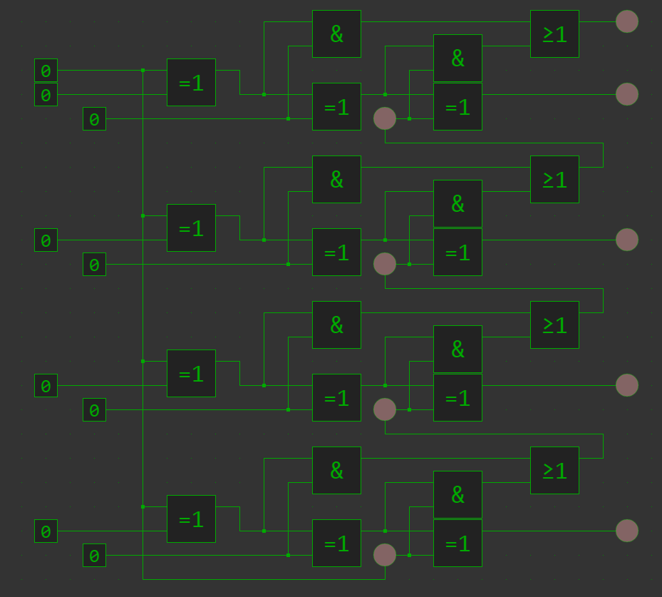
Workshop Plan (Cont.)
Arduino
Basic Programming Block
Digital I/O
Analog I/O
Functions
Interruption
Multi-tasking
Communication
Circuit design

Slide 6
Software Checklist
Arduino
1.8.2
Be sure to get libraries and workshop folder after installing Arduino!
Python 2
2.7.13
Be sure to get workshop folder after installing Python!

Slide 7
Workshop File Checklist
Python 2
12 Workshop script files
1 Exercise Folder
9 Exercise script files
Arduino (In work)
20 Workshop sketch files
1 Exercise Folder
4 Exercise script files
Arduino generates folder for each sketch; do not move the file around!

